Slide 1

Niv Eliyahu
Shachar Males

Slide 2

General Description
The system manages the delivery of vaccinations array for a small town
The purpose of the system is to make sure that every HMO (Health maintenance organization) Will receive a sufficient amount of vaccines depend on the population of the HMO.
The delivery companies can also connect to the system and view in real time the deliveries details.

Slide 3
Users
There are 4 types of users in the system:
The city’s Corona projector (the main user) –Use the system for following all operations of the vaccines delivery array and the vaccinated population.
Delivery companies – Use the system to Receive orders from different HMOs and view the orders details.
HMO – The Health maintenance organization use the system for order vaccines from the laboratory.
Laboratory – Use the system for viewing how many vaccines ordered by deferent HMOs at the time.

Slide 4
Entities
Primary key
Foreign key
Delivery company (CID, Company name )
Store the data of many delivery companies
Laboratory (LID , Laboratory name, City, Street, number)
Store the data of many laboratory companies
Vaccine (VID , LID , Validity)
Store the vaccine ID , validity date and the ID of the laboratory that create them.
HMO ( HMO-ID , HMO –Name , inventory , City, Street, number)
Store the vaccine ID , validity date and the ID of the laboratory that create the vaccines
Order (OID , LID , HMO-ID , CID, Vaccines amount , Supply Date)
Store all the necessary information for the order.
Person (PID , First name , Last name , Phone , Year of birth , VID1 , VID2 ,HMO-ID)
Personal details for finding a person and check his vaccinated status.

Slide 5
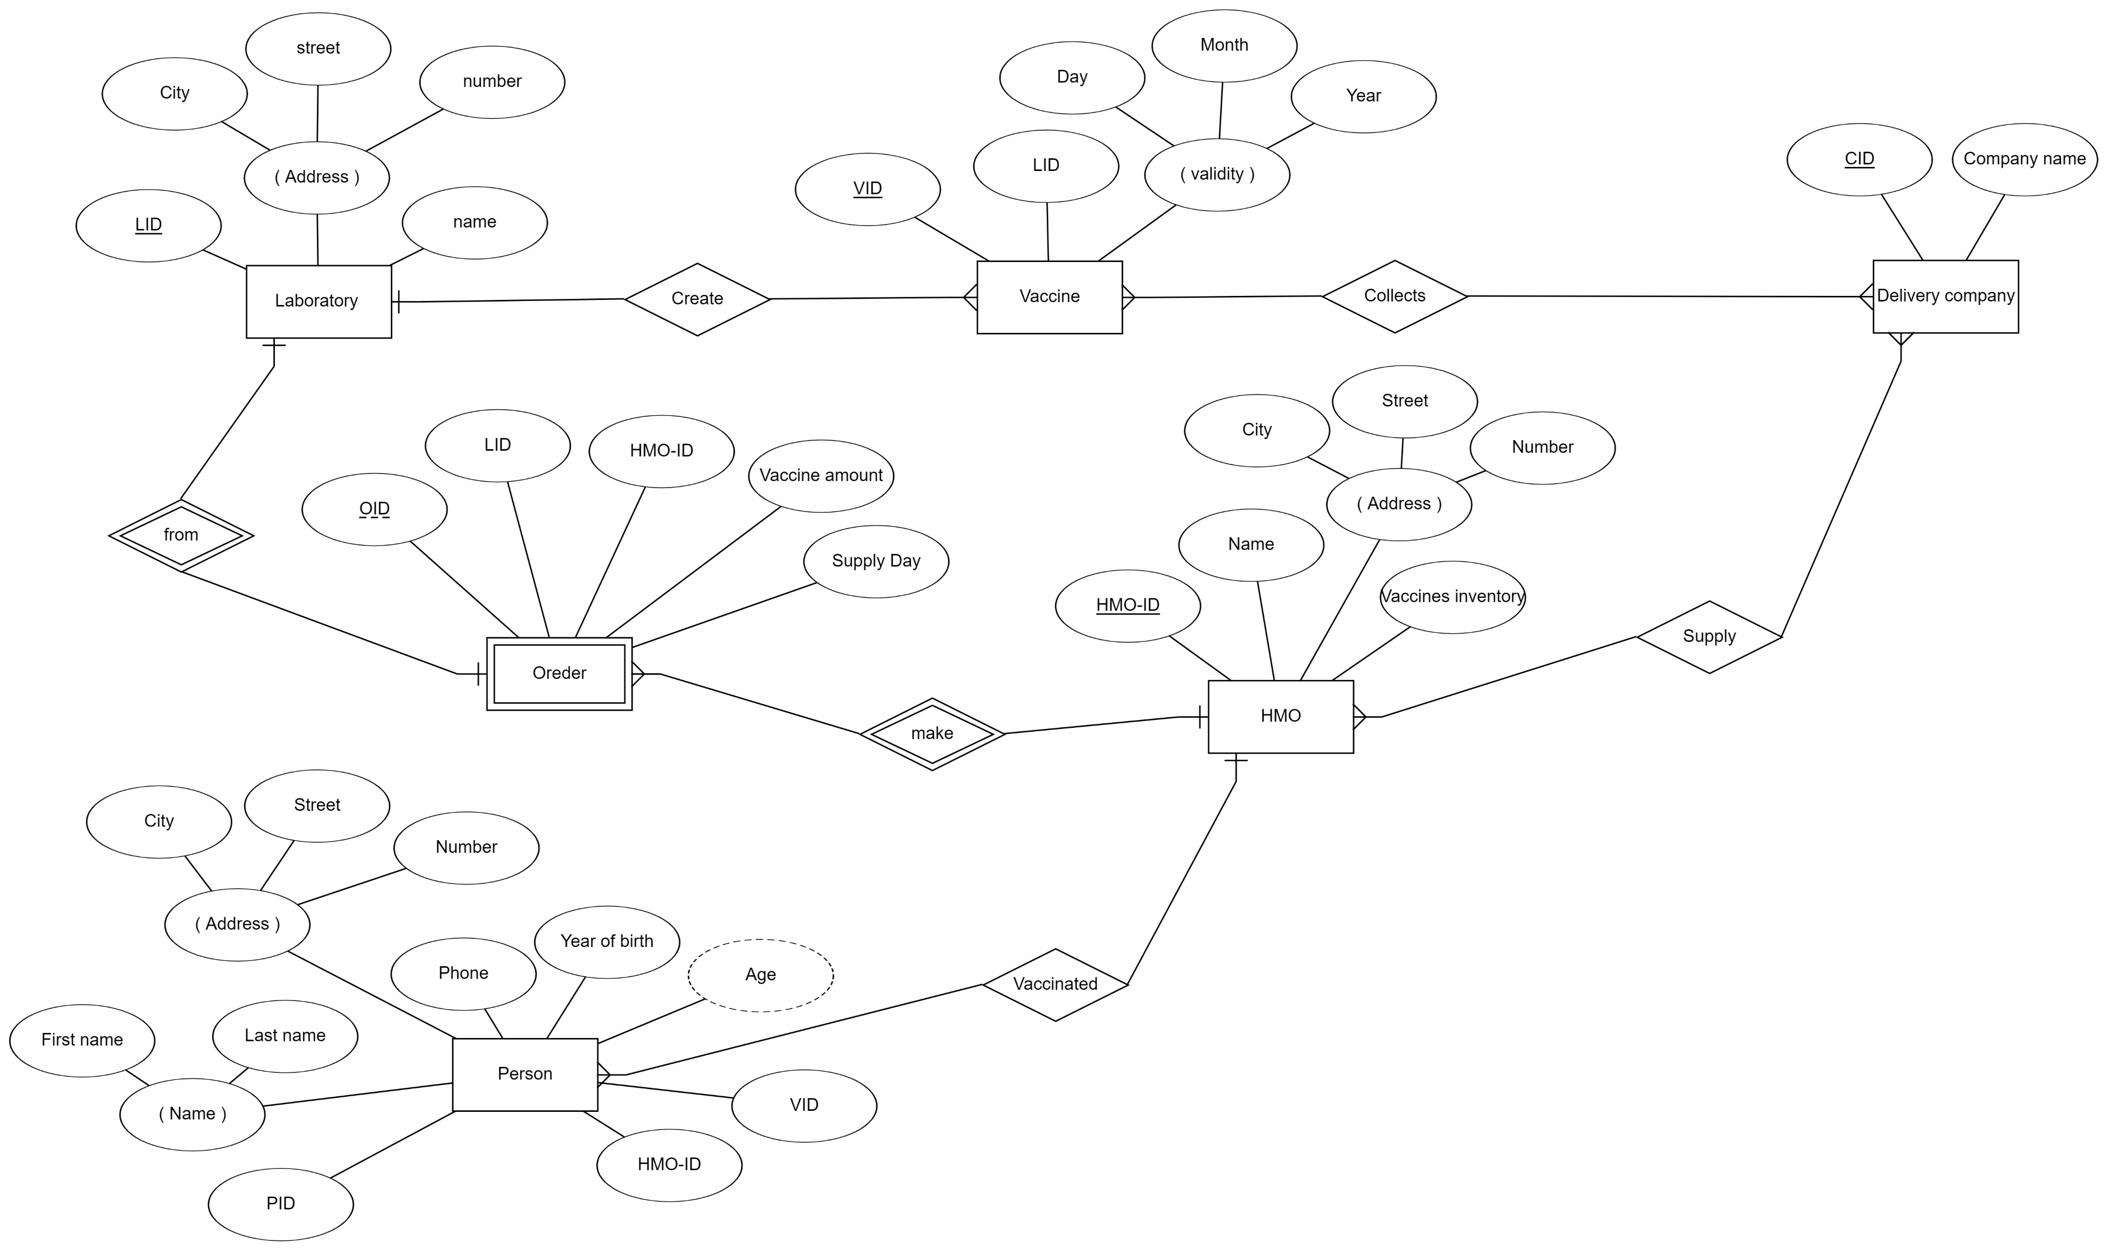
The erd
1
vid2

Slide 6
Queries examples:
The city’s corona projector
Show how many people vaccinated today.
Show the percent of the vaccinated of people over 60 age.
Show the inventory of all the HMOs in the city.
Show all the expected vaccinations orders.
Show the HMO that vaccinated the most.
Show all the laboratories that supply vaccines.

Slide 7
Queries examples:
Laboratory
Which HMO ordered the most vaccines.
Which day is the most popular to supply.
Show all the vaccines which are expired in this week.
Show all the orders to supply for today.
show all the HMOs that order from specific laboratory.

Slide 8
Queries examples:
hmo
Show all the patients that over 60 age.
Show all the future vaccines orders.
Show all the laboratories that supply vaccines.
Show all the vaccines which are expired in this week.
Show current vaccine amount.
Show all vaccinated people in a particular lab.

Slide 9
Queries examples:
Delivery companies
Show the expected order for the next week.
show the lab that orders the most deliveries
Show all HMOs that receive orders today.

Slide 10
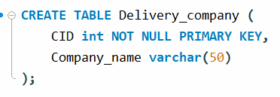
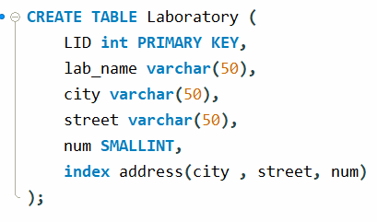
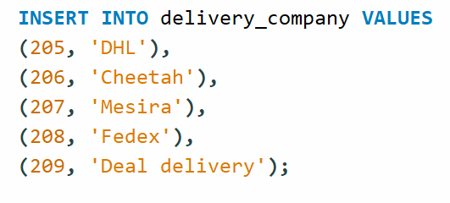
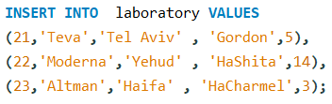
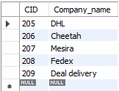

Creating the database and INSERTING DATA

Slide 11
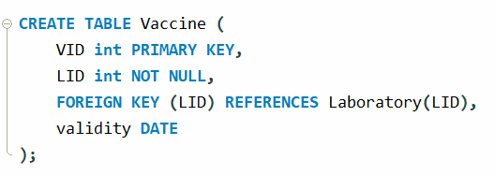
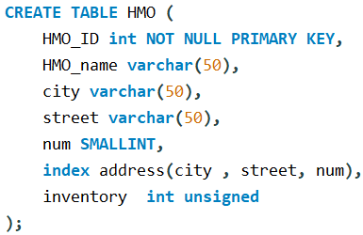
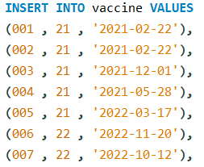
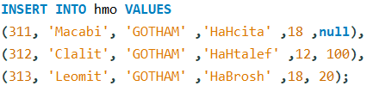
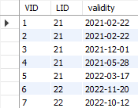

Creating the database and INSERTING DATA

Slide 12
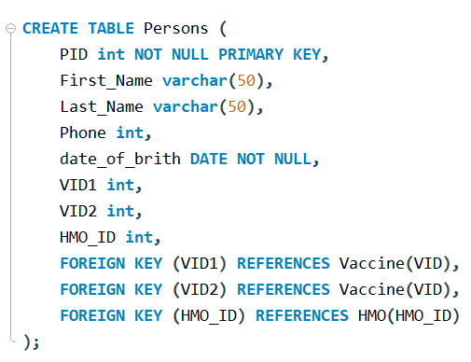
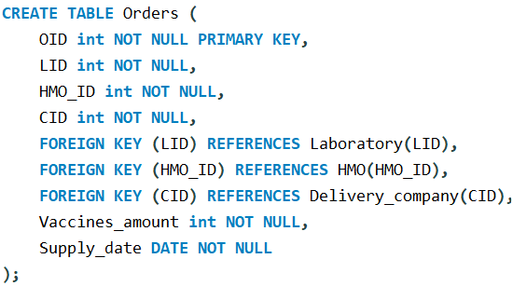
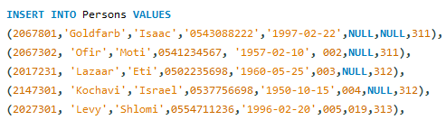
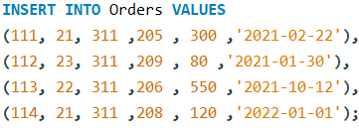
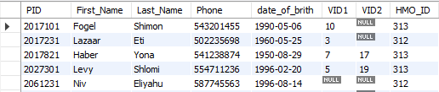

Creating the database and INSERTING DATA

Slide 13
Triggers
Insert triggers:
Check for valid supply date, if not valid set supply date for the next week.
Check if the date of birth is valid and if not send an error message.
Update triggers:
If a person gets vaccinated, the vaccine inventory in his HMO gets an update. (subtract one vaccine from the inventory)
If vaccine validity gets expired, the HMO’s inventory gets an update. (subtract one vaccine from the inventory)

Slide 14
updates
Update the number of vaccines for the existing order.
Update the supply date for existing orders.
Change HMO\laboratory address.

